Slide 1


🎼 Record Shop Inventory App
Takako Onozuka

Slide 2


Meet my client
Name: Richard G
Age: 72
Location: Ayr, South Ayrshire
Occupation: Semi-retired / Runs a small record shop, Seaside Records. Sells records both in person and online.
Lives with: Partner and two dogs

Slide 3
What my client said:
I want something to organise my records.
My eyesight is not in the best condition, so I’d like something simple and easy to understand.

Slide 4
What Richard can do with Record Shop Inventory App
BASIC funtions:
VIEW
All the records
All the artists
All the genre
Record details
Artist details
SORT
By artist
By genre
CREATE
Record entry
Artist entry
Genre entry

Slide 5
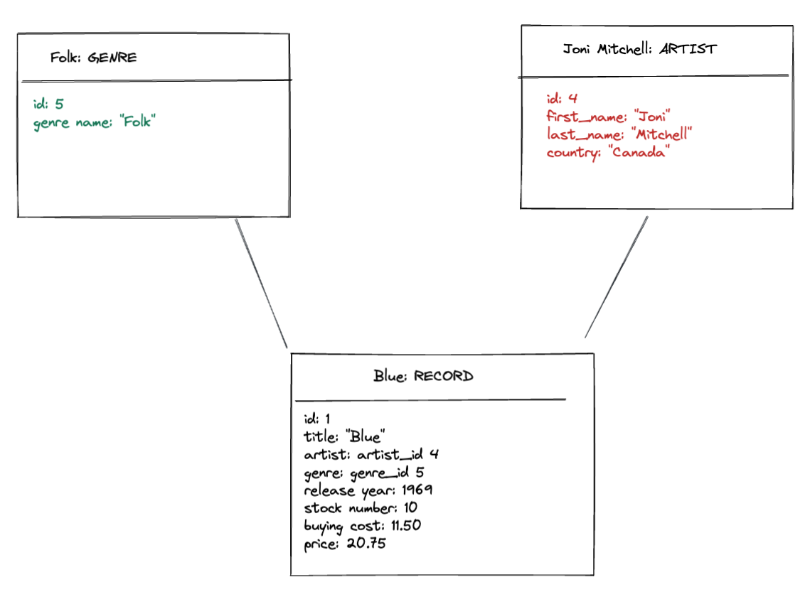
Object diagram

Slide 6
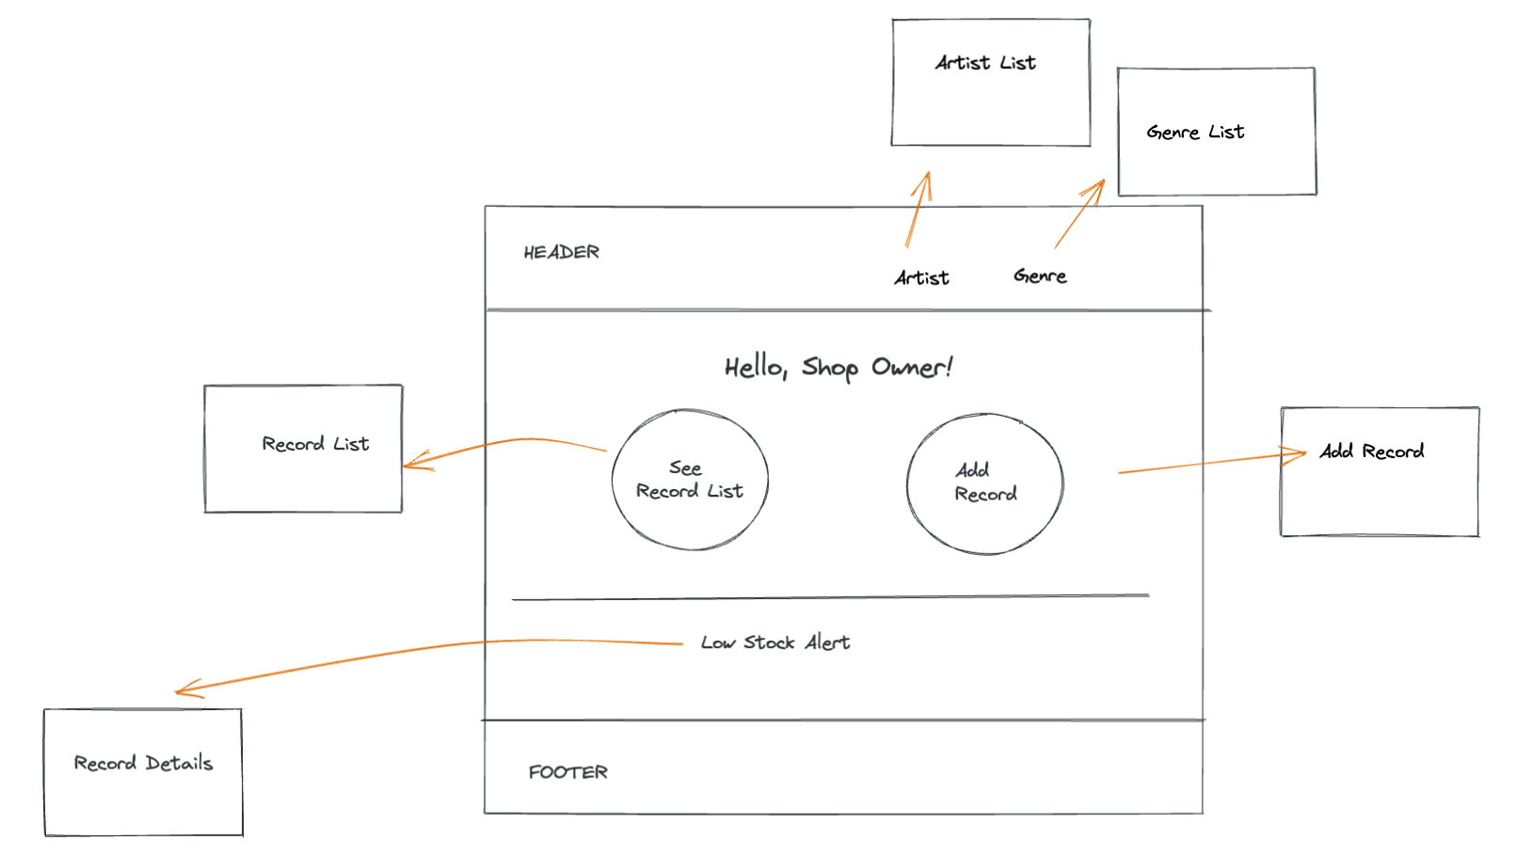
Wireframe : “Home” page

Slide 7
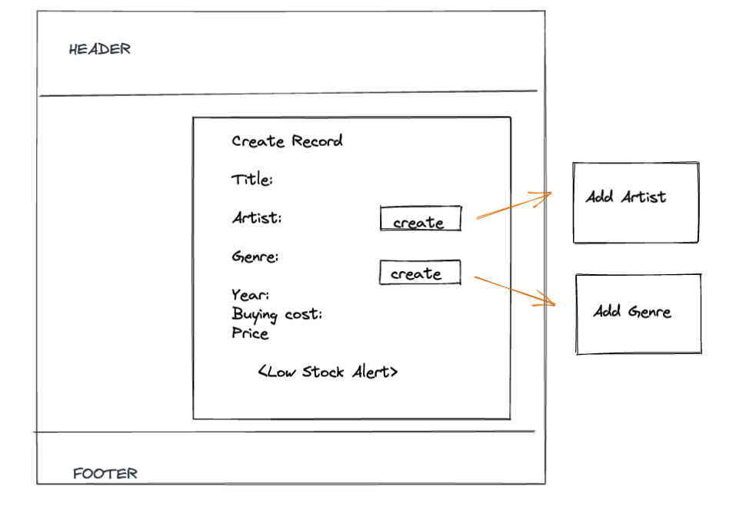
Wireframe : “Add” page
select from the list
select from the list

Slide 8
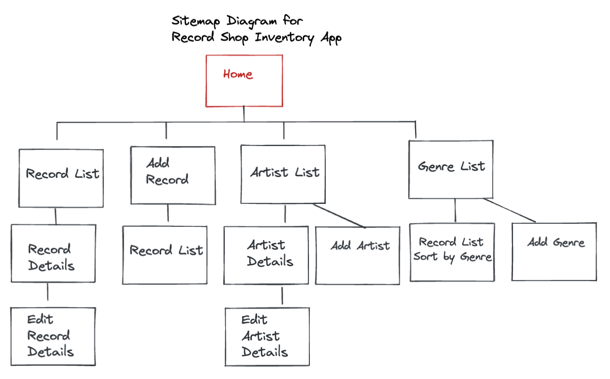

Slide 9
What Richard can do with Record Shop Inventory App
PLUS funtions:
Gets “low stock” notification when the stock is less than 3
View a markup for each record
View artists in alphabetical order
Contact me if there is any issues

Slide 10

Demo time!
One of Richard’s dogs, Connie

Slide 11
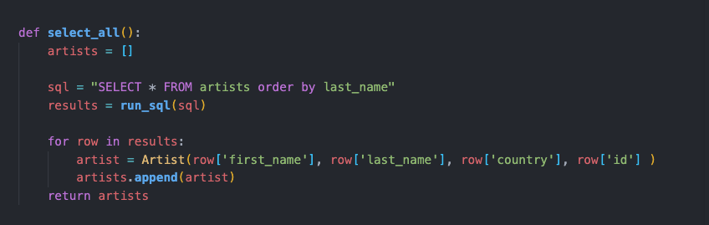
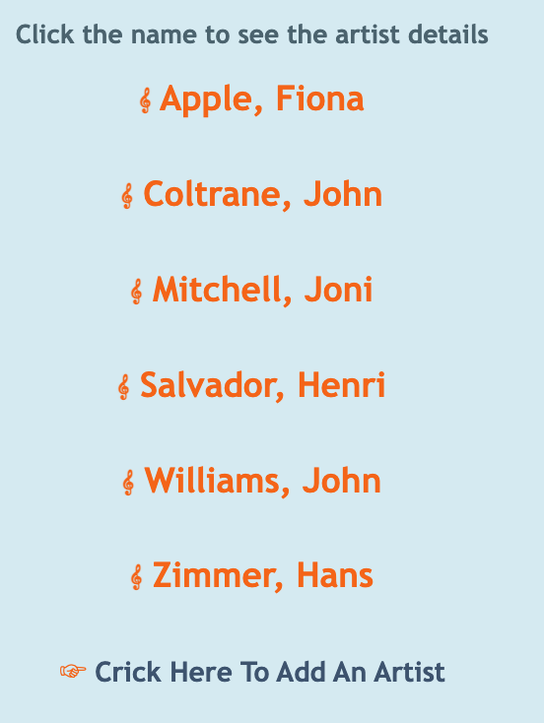


The memorable code for Record Shop Inventory App
artist_repository.py

Slide 12
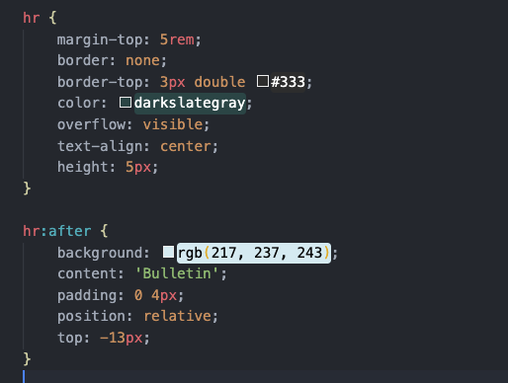
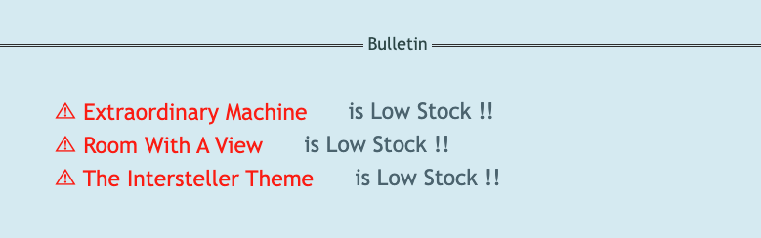
The memorable code for Record Shop Inventory App
home.css

Slide 13
What I am happy about Record Shop Inventory App
Interactive
Calculate the markup automatically
As an extension, I decided to add the third db table. Record db table references Artist and Genre tables. And it worked!

Slide 14
What I learnt from Record Shop Inventory App
(Apart from the obvious...)
How to read error messages
30 minutes of planning could save a whole afternoon.
Exta 30 minutes of coding while tired could cost a whole next day.
Other people can spot your mistake better than you.

Slide 15

Next Step For Record Shop Inventory App
Add “View Sales” page to see monthly / weekly sales and profit.
Add “Image Upload” on ”Add Record” page, so images of each record will appear on the record list

